Slide 1
Shift-Left Security:
More than just a catchphrase
Vince King
March 2023
Notes:
Shift-left Security: More than just a catchphrase
Vulnerabilities like Log4j may be headline grabbers, but thousands of applications are being targeted by hackers who use flaws in code as attack vectors. Vulnerabilities such as cross-site scripting and improper authorisation are on the increase, and with the increased use of open source software we need to ensure "shift-left security" is more than just a catchphrase.
During this presentation we'll look at:
- what modern development looks like
- what developers want
- what developers actually need
- what IT professionals should look for in DevSecOps tooling and how it can help

Slide 2





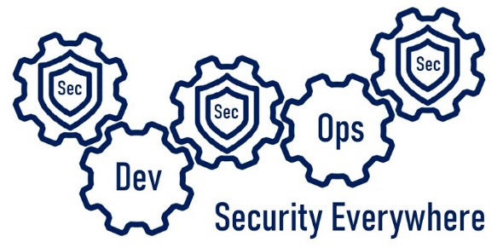

#whoami
Vincent King
Senior Cyber Analyst
Head of DevSecOps
Bank of England
Reformed Developer
Secure Coding Subject Matter Expert
(ISC)² Certified Information Security Professional
Chartered Fellow of the BCS
DevSecOpsVince
Notes:
My name is Vince King. I’m a reformed developer, and have held numerous roles including Ops Lead and DevOps subject matter expert having created the DevOps capabilities from the ground up. I produced and run training courses on secure coding practices. I have extensive Cyber experience having worked in Vulnerability Management, GRC, Education and Awareness, and Cyber Security Framework implementations.
With my experience in DevOps and Cyber Security, I now lead the effort for DevSecOps within the Bank of England. However, I’m not here as a representative of the Bank, so please no questions about interest rates or Monetary Policy Committee decisions. Asking me about economics is as useful as asking a 4 year old to solve a quadratic equation!
Now a word on what this presentation is, and more importantly, what this presentation is not. This presentation is an overview of what DevSecOps is; Why is it important; and Why it isn’t just “shift-left”.
This presentation is not a discussion about specific tooling or vendors. It is not a indepth course of best practice. Most importantly, it is not the silver bullet that will immediately solve all the DevSecOps problems for you!

Slide 3

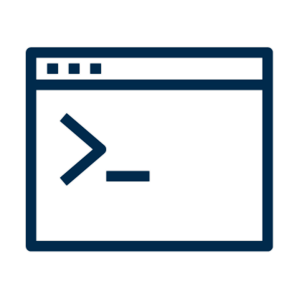


DevOps vs Security – The Perception
Dev
Dev
Sec
Ops
Notes:
Hopefully we all know what good DevOps looks like. Or at least we have read what it is supposed to look like.
Small teams working independently to implement their features, validating correctness in pre-production environments, with deployments into production happening predictably, quickly, safely, and securely, throughout the business day.
But why is reality not like the books? Having worked across multiple roles, I have some strong feelings about this!
As a developer I saw Cyber Security as a blocker to my freedom. It was stopping me using all the tools and code-snippets I found on the internet. I would avoid Cyber people because they were the department of “no”.
As a DevOps lead I saw Cyber as an impediment to innovation. Why couldn’t I have admin rights on every machine within the enterprise so I can run unsigned PowerShell scripts to performed deployments?
As an Ops lead I saw Cyber as the reason my new features were taking so long to reach production.
Finally, as a Cyber Analyst I saw that I was an idiot…. But in my defence, it wasn’t all my fault. Within most Technology departments Cyber Security and their policies are perceived as obstacles to be worked-around. Their lack of open engagement supported their clandestine reputation.
We hear a lot to talk about “shift-left” security. It’s a phrase I don’t particularly like, but it is important to know why, now more than ever, it matters. We as IT professionals are not the only ones “shifting-left”!

Slide 4





Scary Slide No.1
Notes:
Firstly … I’m going to assume that everyone listening to me is aware of, and uses source control. Even if it is Visual Source Safe!?!?
In August 2019, GitHub was called out in a US lawsuit following the Capital One breach. The reason? Allowing social security numbers to be stored in a Git repository.
In October 2019, one misstep from developers at Starbucks left exposed an API key that could be used by an attacker to access internal systems and manipulate the list of authorized users. Lucky the vulnerability was reported as part of a bug bounty program and quickly resolved.
In January 2021, a misconfigured Git server at Nissan North America lead to the leak of the source code of the company's mobile apps and internal tools. A Git server was left publicly exposed with a default username and password of admin/admin.
More recently, in December 2022, Okta reported a breach that included the unauthorised downloading of source code. Access was possible through the use of stolen authorisation keys and could have been related to an extension phishing campaign in September of last year.
While still reading and digesting the information around the Okta breach, a few days later we got news of an attack on Slack. The incident involves threat actors gaining access to Slack's externally hosted GitHub repositories via a "limited" number of Slack employee tokens that were stolen.
Can anyone see the connection between all of these incidents … other than they involved source control?
They all involved human error. Tooling on its own cannot guarantee that everything we do is secure … but they can help to protect us against ourselves.

Slide 5
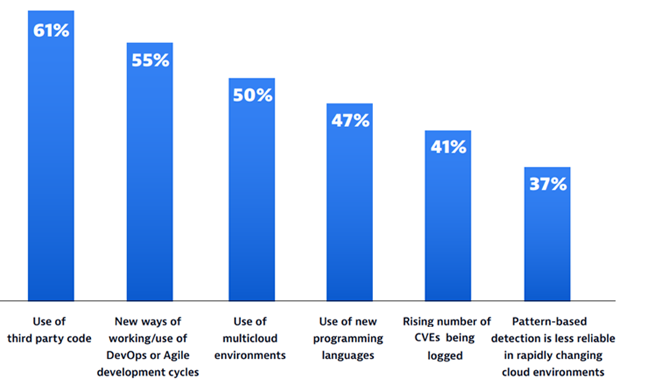
Scary Slide No.2
68%
of apps had a security flaw that fell into the OWASP Top 10
Notes:
Do we have any CISOs here this evening?
In a recent report from Dynatrace (Dynatrace Global CISO report 2023), CISOs were asked to identify factors that made it more difficult to pinpoint and resolve application vulnerabilities.
61% said that the use of 3rd party code caused issues. If we think about Log4J a number of organisations believed they where not exposed until they started to think about the dependencies not just of their own code, but the dependencies of the packages they use, and the exposure their vendors had.
I love the second value … 55% blamed DevOps and Agile. Two of the great innovations in the development world are causing our Cyber leaders pain. Development is becoming too efficient and moving too quickly for security to keep up!
Finally, another recent report provided details of scans of 130,000 applications which found that nearly 68% of apps had a security flaw that fell into the OWASP Top 10. Hopefully we are all aware of OWASP (Open Web Application Security Project); the Open Source Foundation regularly revise and publish their top 10 vulnerabilities found in Web apps. The most recent (2021) has broken access control at number 1. Injection (including SQL Injection) is always in the top 10, this time at number 3. So what can tooling do to help our CISOs sleep better and our developers to avoid some basic mistakes?

Slide 6
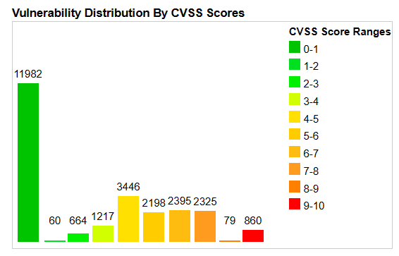
Scary Slide No.3
25,226
Common Vulnerabilities and Exposures (CVEs) were published last year alone.
57%
report that their breaches could have been prevented by installing an available patch
34%
victims knew of the vulnerability, but hadn’t taken action
Notes:
With a strong secure development culture. We can build reliable, repeatable, and secure deployments, but the work never ends.
25,226 Common Vulnerabilities and Exposures (CVEs) were published last year alone; and increase of 25% from 2021. Almost 70 per day! This year already there are almost 5,000.
Of those 26,000 CVEs in 2022, 3.4% (860) had a CVSS score between 9 and 10, the most critical.
A report on the State of Application Security (Forrester) tells us that 57% of cyberattack victims report that their breaches could have been prevented by installing an available patch. Even more chilling, 34% of those victims knew of the vulnerability, but hadn’t taken action
74% of companies say they simply can’t patch fast enough because the average time to patch is 102 days according to Ponemon.

Slide 7

Where should Sec live?
Sec
Sec
Sec
Ops
Dev
Security Everywhere
Notes:
So, how do we fix it, and where should Security live in the SDLC? Well … everywhere.
Work must be done to create a culture of collaboration between development, operations, and security with engagement being established as the earliest stages of a project or change, and running throughout the lifecycle.
Too often Security, like testing, is an afterthought. Problems are found too late to be corrected in time, and the system moves forward, running at risk. Here starts the technical debt spiral. Promises of, “we’ll fix this later” are rarely delivered due to other pressures.
Add in Cloud to this situation and part of this debt could lead to a major compromise or data breach on a massive scale.
As part of the culture change required to fully adopt DevSecOps, Security must work closely with Development and Operations, and most importantly, be an enabler. An important part of this is going to be the choice of tooling.

Slide 8



Vince’s Three “i”s of Tooling for Developer Enablement
Integrations
Intelligence
Insights
IDEs
Pipelines
Policies
Audit Mode
Speed
Sources
Zero days
Recommendations
Vendor data
Communication
Prioritisation
Custom Code/SBoM
Licences
Trending
Enterprise Visibility
Notes:
So, what should we be looking for. I recommend using Vince’s 3 “I”s of Tooling for Developer Enablement!
Integrations
Good developers are complex creatures and come in many shapes and sizes. However, they often share some common characteristics. They are good problem solvers and enjoy a challenge; They don’t enjoy bureaucracy and can put a lot of effort into working around it; They don’t like interruptions especially is it involves “constructive” feedback!
So, any tool, especially something that is going to be looking over their shoulder, must integrate with their way of working and the closer it can get to the developer coalface, the better. Developers live in their IDE and tools must be able to be incorporated easily.
Outside of the IDE, because of the well documented benefits of DevOps, Developers can no longer rely on “well it works on my machine” and CI/CD pipelines are a must for any successful development culture. Combining DevOps with Security needs to be managed carefully to ensure that we don’t create blockages that the Developers will want to work around, or worse ignore altogether.
From a DevSecOps point of view tooling must give Security the ability to create a safe space for Developers. A walled garden that allows play and experimentation, but won’t let them hurt themselves, or others. The ability to create policies will provide guidance, support, and the occasional slap on the wrist to keep the developers honest.
A quick side note of policies. Too often I speak with Cyber Security departments that are at odds with Developers. This is typically due to overly restrictive policies that, on paper, are the right thing to do, but hobble Developers in their day-to-day work. When challenged, Security respond with “you must comply”. It’s important to create evidence-based policies, and review them regularly. This way the everyone involved can have confidence that the policies are appropriate and pragmatic.
When introducing a new tool or process, too often it is all or nothing. One day everything is working, the next, everything is failing. What happened? Someone turned something on without understanding the impact. Whether this is a new tool, firewall rule, or policy, ensure you are able to run a “what-if” testing period.
Finally for Integrations, consider the impact new tooling or policies will have. There will always be a trade off between speed and accuracy. Understand your risk tolerance and where your developers and security professionals feel comfortable while remaining productive.
Intelligence
As we’ve already heard, in 2022 there were on average, 16 high or critical vulnerabilities identified every week. Keeping up with this can be a full time job, so we need a tool that aggregates information from sources like NIST, NVD, SANS, OWASP, and the wider community to keep us informed.
Over the last few years we have seen a worrying trend in how quickly vulnerabilities are being abused. Time to exploit has come down from months and years, to weeks, and sometimes even days. Zero days are a fact of life in modern IT, but having a tool that can support you by keeping you up to date with remediation steps is vital.
This applies not just to zero days, but to all vulnerabilities. Often explanations provided by Cyber professionals can be complex and confusing and Developers are reduced to saying “just tell me how to fix it”. Unfortunately, few security staff fully understand the remediation, given that it could be in any programming language, or component of an application. A tool that can provide technology-specific recommendations in terms those who will be responsible for fixing any issues is invaluable.
Any company that is operating today is gathering huge amounts of data, and security application vendors are no different. With every scan that is run, with every package that is reviewed, with every issue highlighted to a Developer or Cyber Analyst, there is data to be recorded and used. This data should be fed back into the tool to improve recommendations and give confidence in remediations.
Security application vendors should go further and be open with their findings. A popular trend is for companies to release annual reports that share information on the state of application security. More and more we are seeing vendors participate in ethical disclosure programs… a rising tide lifts all ships!
Insights
With so much information available on vulnerabilities, proof-of-concept code availability, and exploits in the wild, it can be overwhelming to know where to start. Being able to avoid alert fatigue and concentrate on what is really important is a must. You may have a low severity vulnerability that affects every system you have, but it’s the one instance of a critical vulnerability that you should be worrying about. Tooling must help us prioritise our work.
I’ve spoken a lot so far … and don’t worry, I’m almost done! But if you remember only one thing from this presentation it’s this: Risks without context are meaningless. Too often an vulnerability gains notoriety, usually when it gets a cool name or appears on the mainstream news, and companies scramble to determine exposure and plan remediations. We’ve all probably been involved in meetings where tensions were running high about an issue that had no impact on us. However, when a headline grabbing vulnerability such as Log4j comes along, we need to be able to quickly understand our exposure. Log4j focused the spotlight on a previously overlooked aspect of software development; our dependencies. I spoke with numerous development teams who confidently stated that their code wasn’t affected, only to find out that one of the packages they use was. With an estimated 80% of code not being written by your developers, it is vital to understand not only your code, but the complete Software Bill of Materials for your application.
Similarly, any package that is used probably has a licence. Remember, open source doesn’t always mean free. Use tooling to track package usage and highlight any issues, because I can guarantee you that Developers are not going to read the terms and conditions.
So, we’ve got the tool, we’ve created the processes, and we’re building a strong culture, but how do we know if it is working? Metrics like Meantime to Remediate, number of critical vulnerabilities, and number of successful builds are all good indicators of the current state of play, but more important is how these values compare to yesterday, and the day before. Are we getting better? Tooling should be able to track these metrics and show trending data to help us justify our existence to senior managers!
Finally … We’ve done all this good work, but too often we don’t tell anyone but a select few stakeholders. I see it too often, so I’ve a huge advocate of highlighting the good as well as the bad. Use tooling to share data with the whole company. It can be uncomfortable at times, but open and honest communication are key to continuous improvement. Ask me later about my year long project to passive aggressively improve our posture management.

Slide 9
Notes:
Hopefully there was something in this presentation that you agreed with, or sounded familiar. One of the phrases I really dislike is “DevSecOps is a journey”. To me “journey” gives the impression that there is a destination, and we’ll eventually arrive at our DevSecOps eutopia.
To me DevSecOps is an adventure. There’ll be ups and downs, and we’ll most likely lose a few people along the way, but as long as we all understand the direction we are going in, striving to make things better, and are using the right mix of People, Processes, and Tooling, we can’t help but learn and improve.

